Slide 1
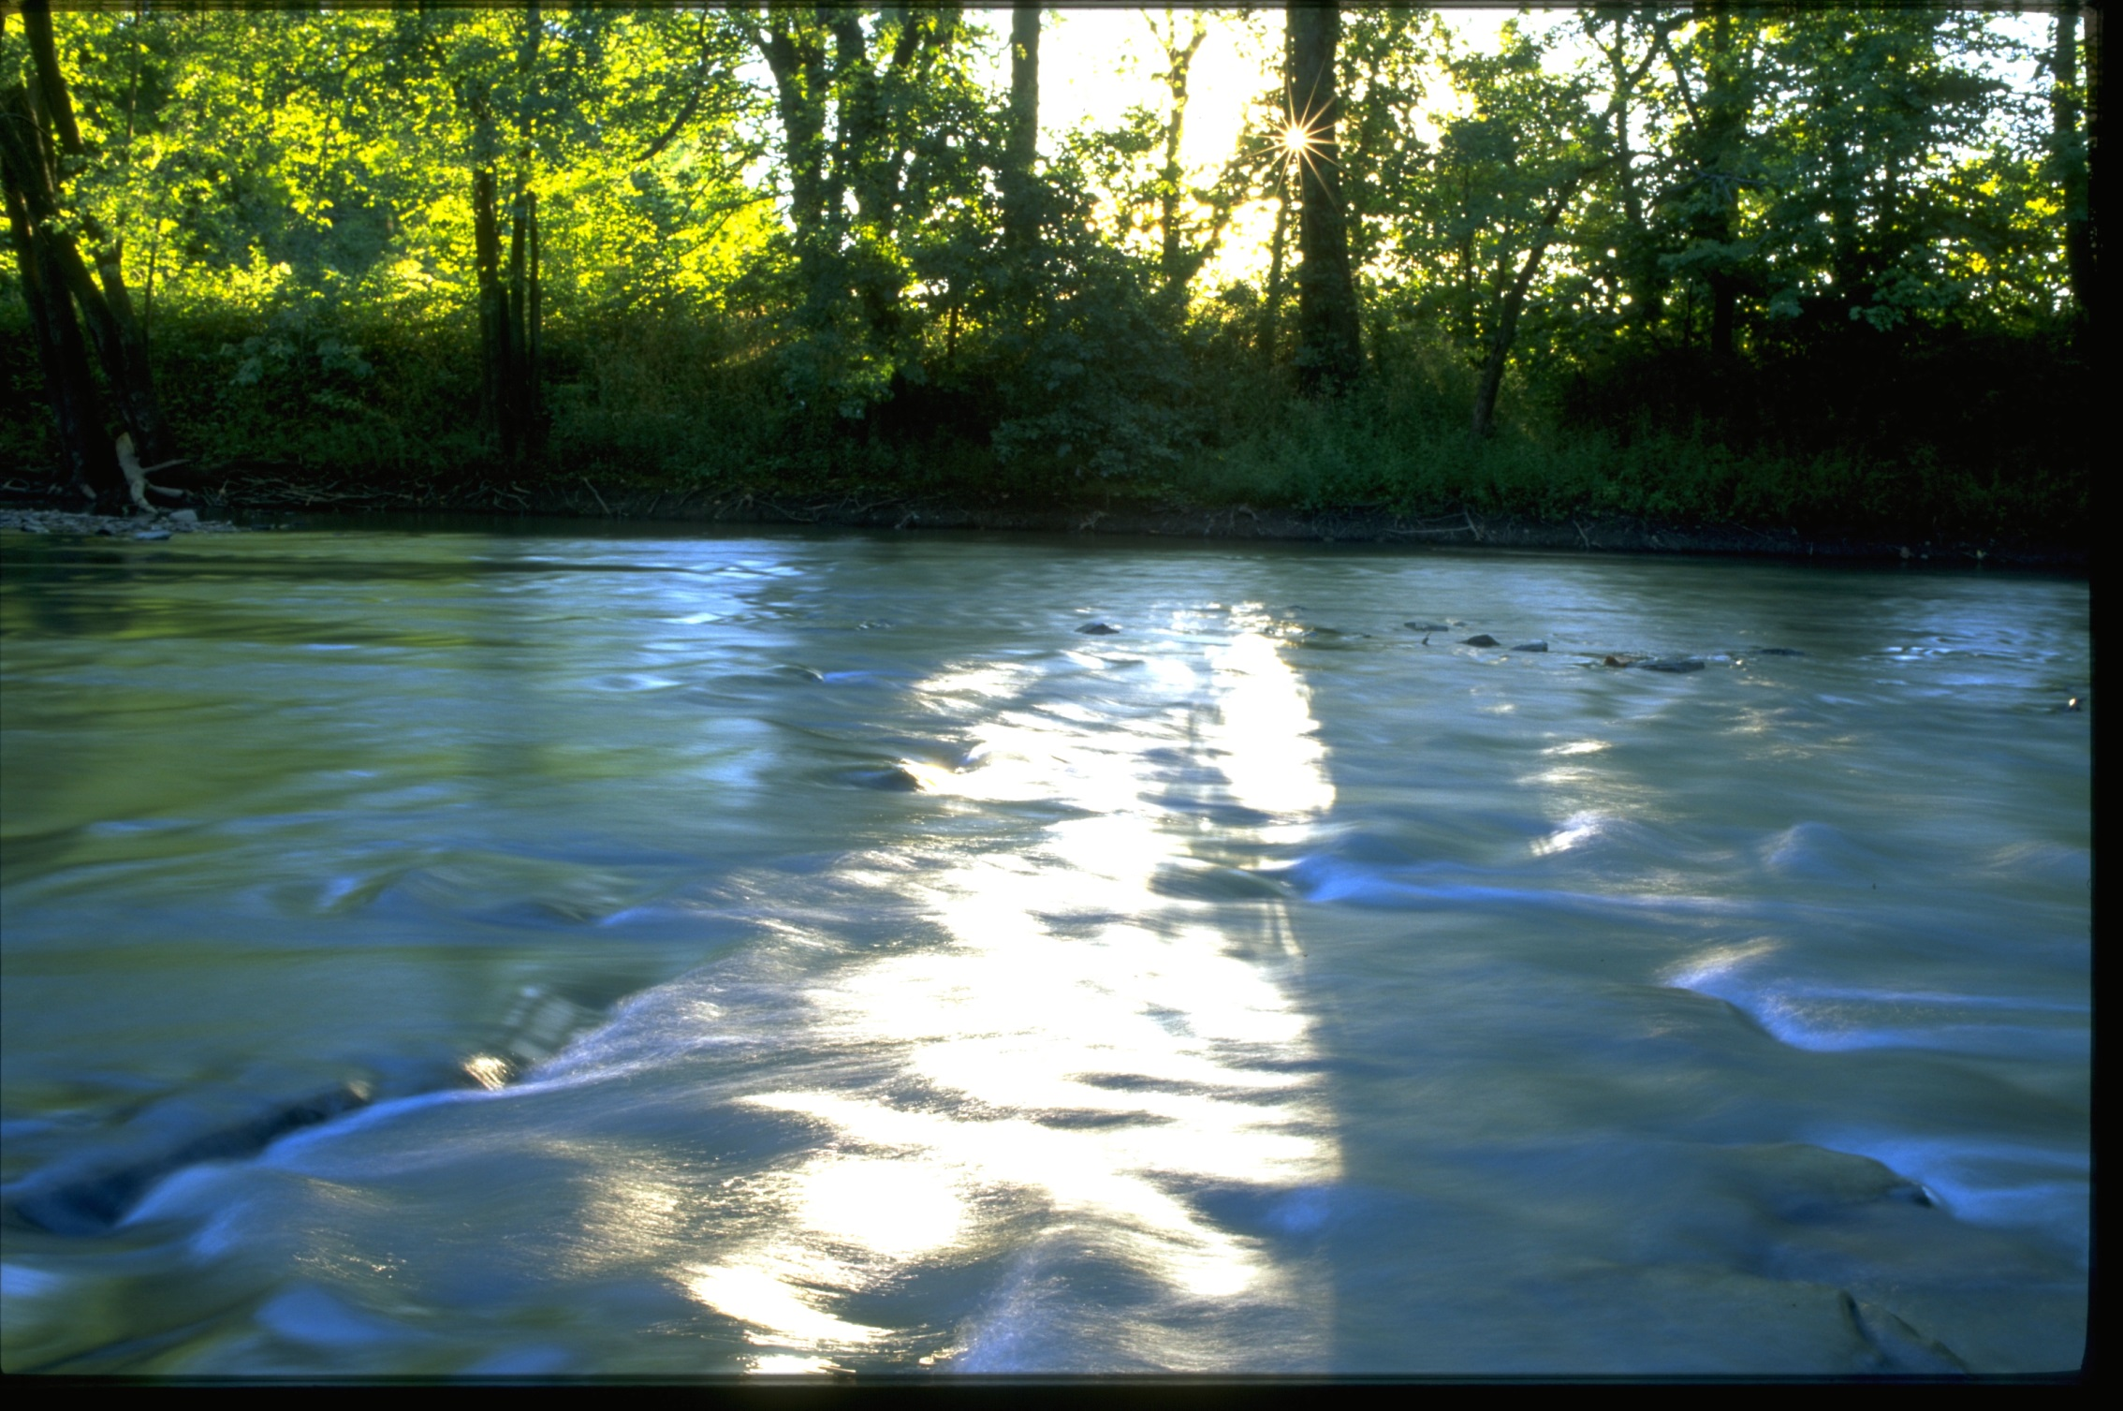
Thank you to all of our members who have made the past 50 years possible

Slide 2
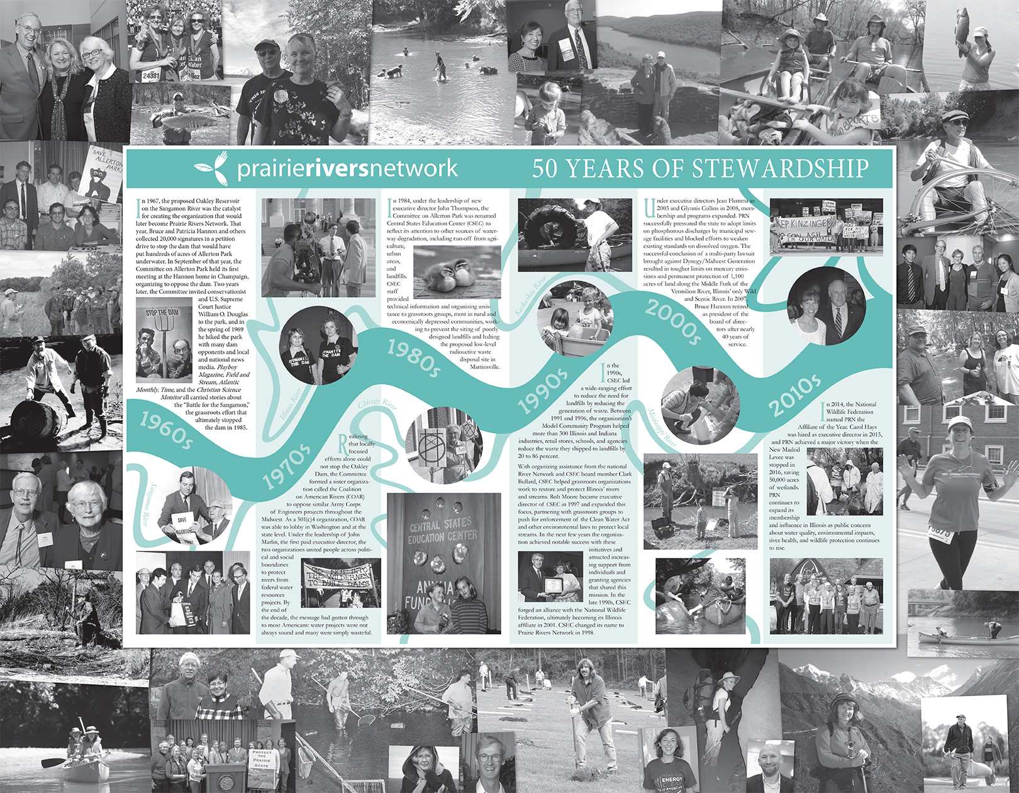
Welcome

Slide 3
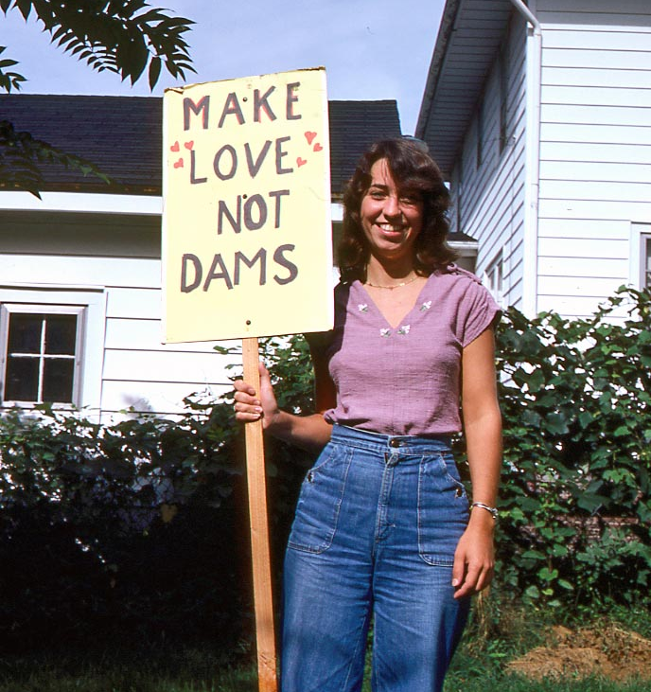
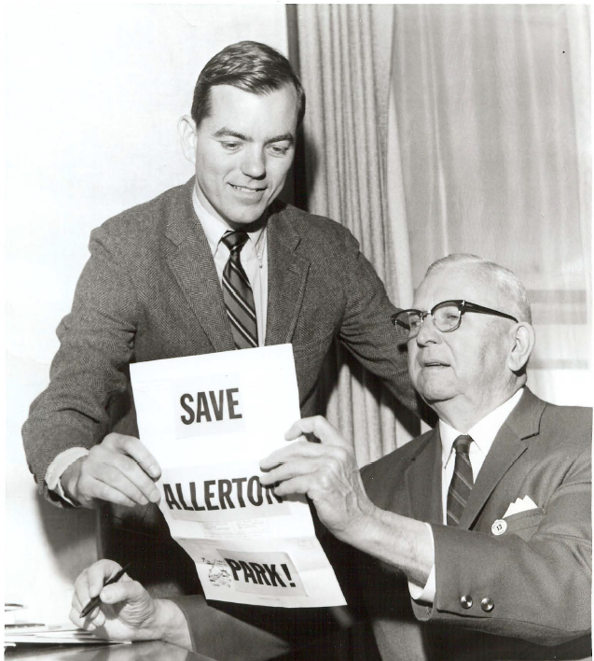
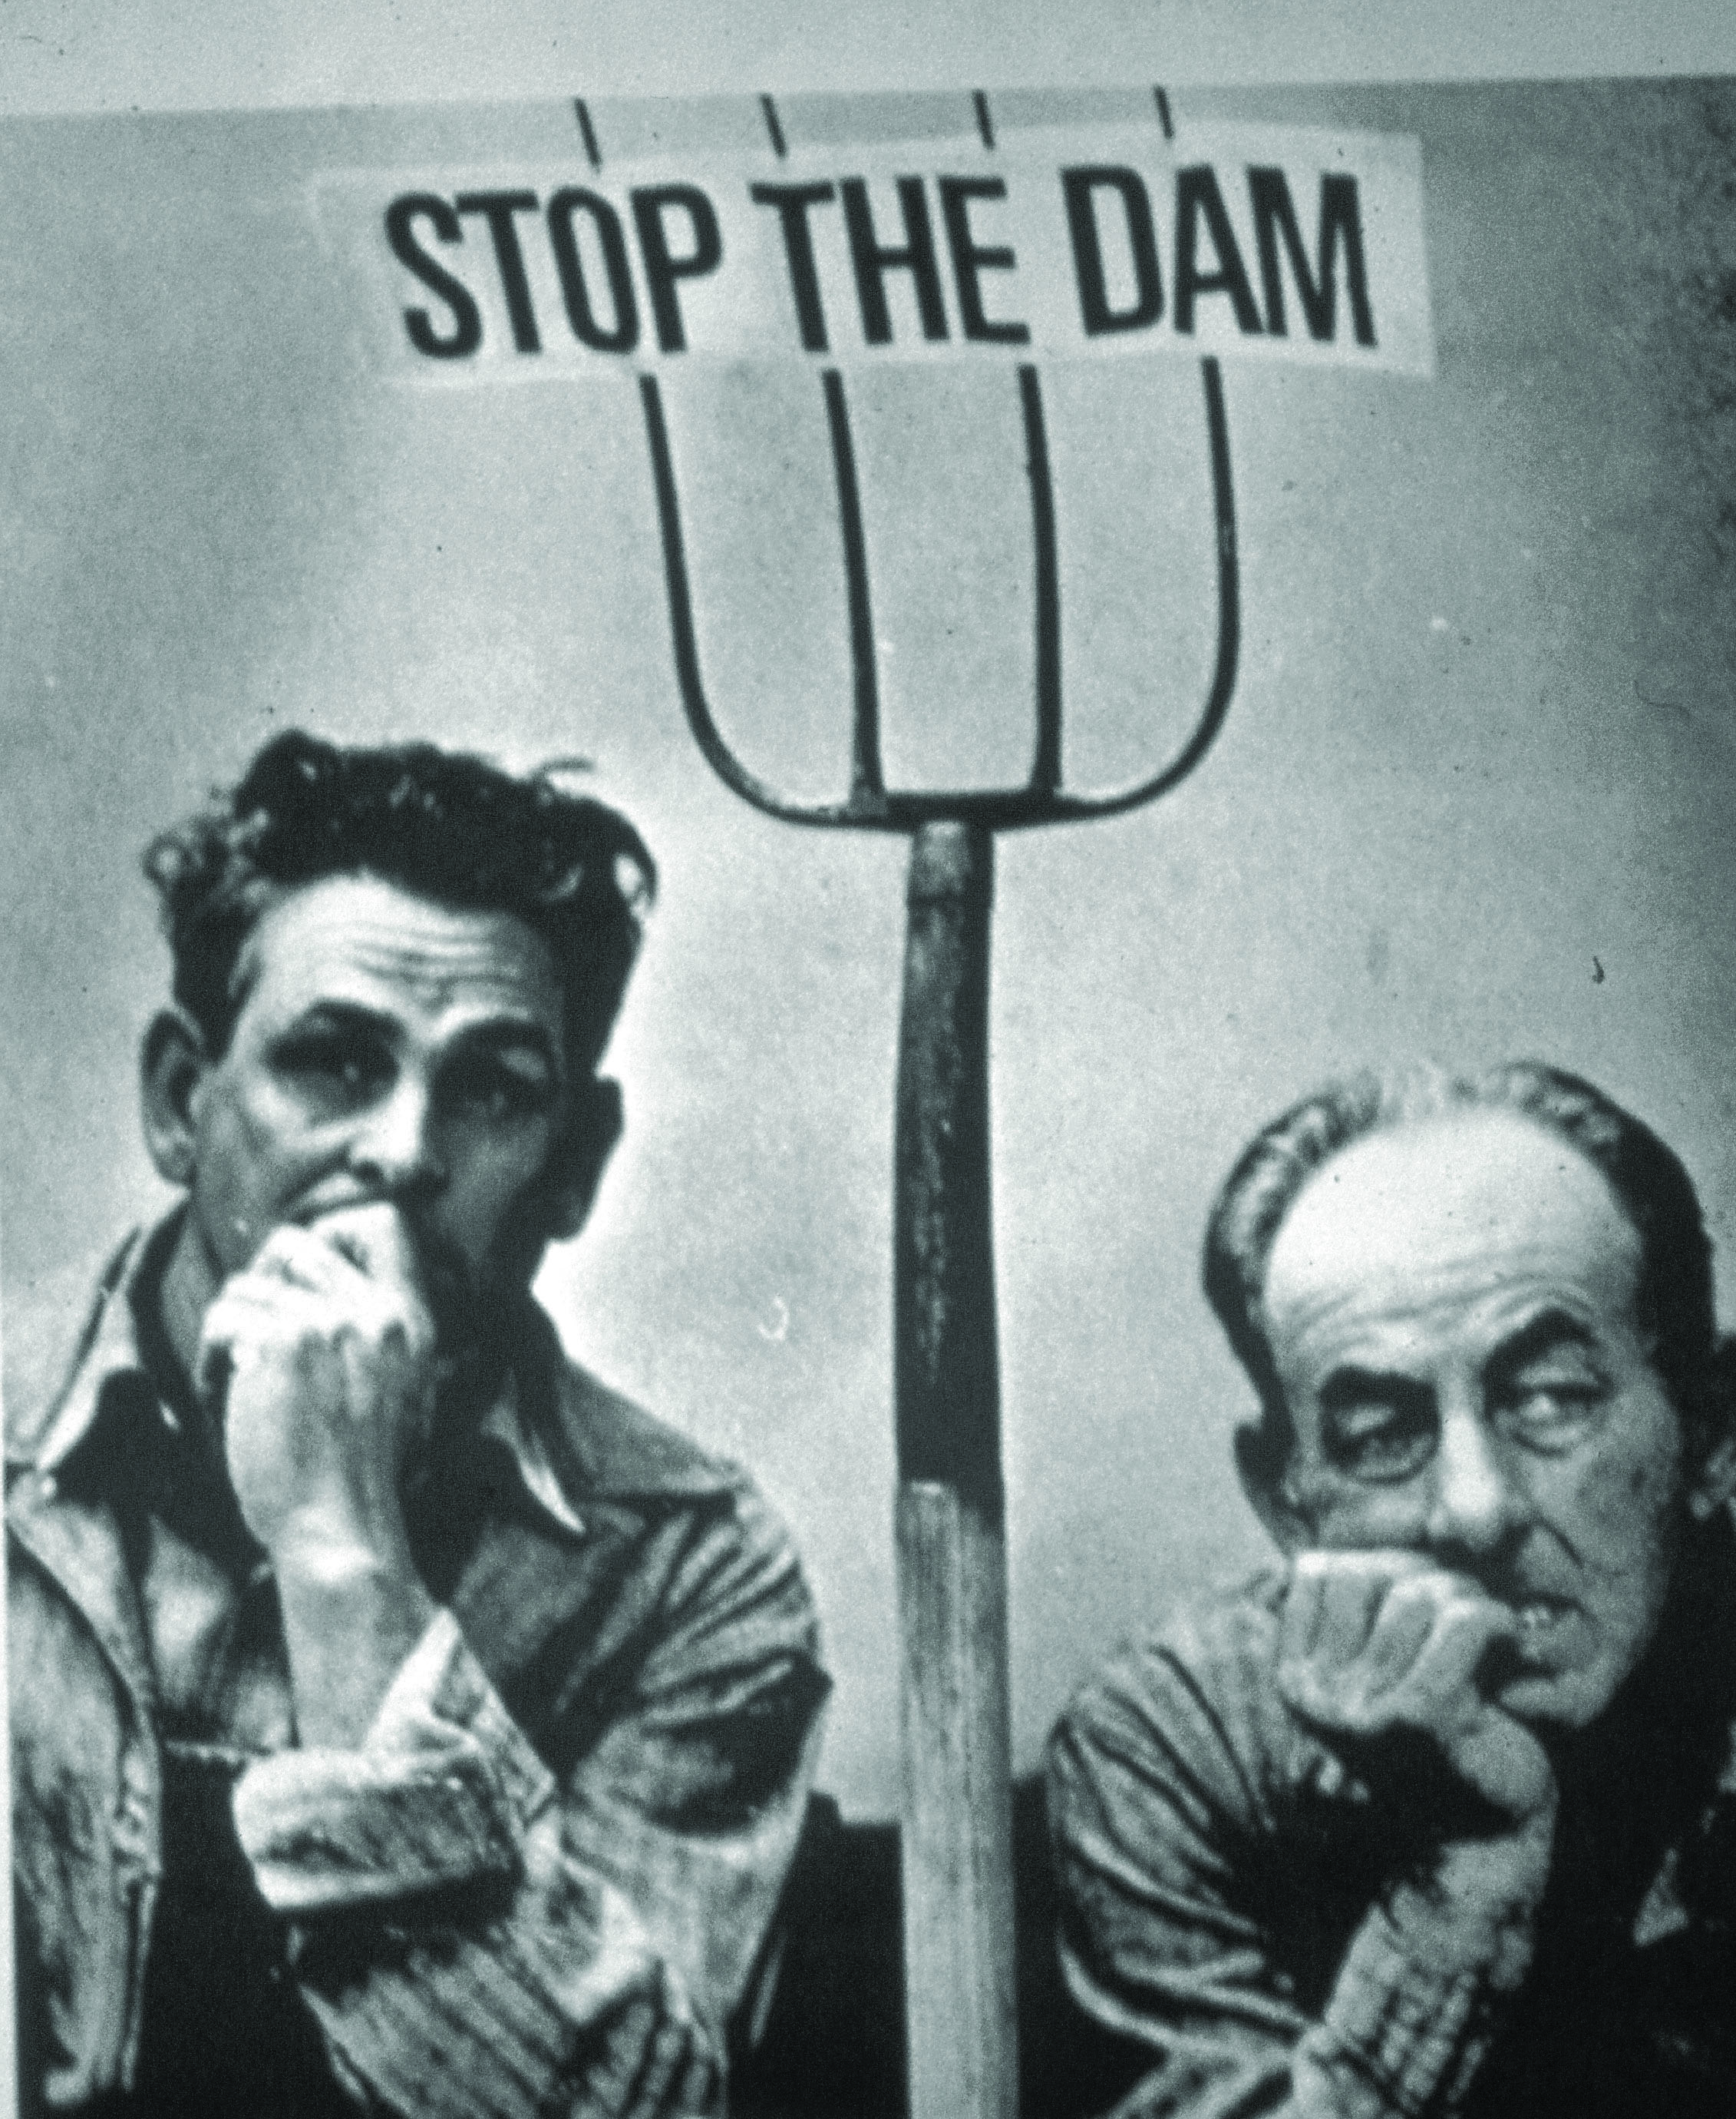
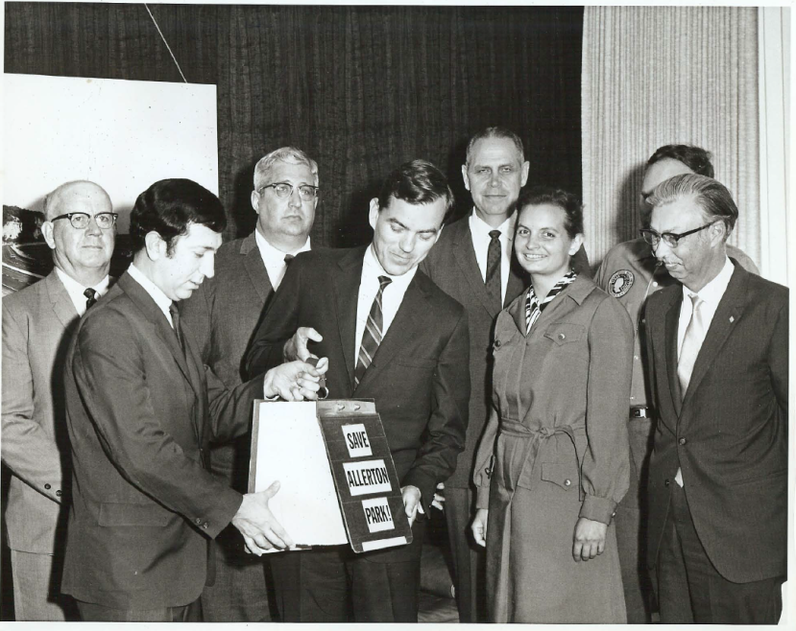
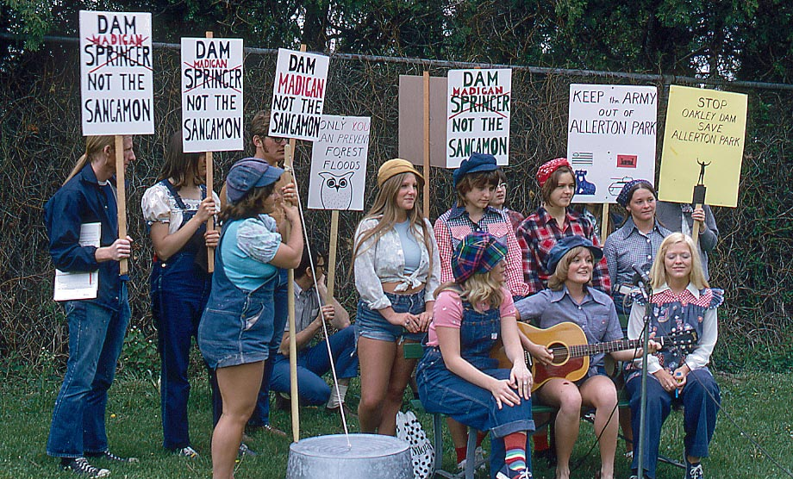
1967: Starting the Fight to Stop the Dam and Save Allerton

Slide 4
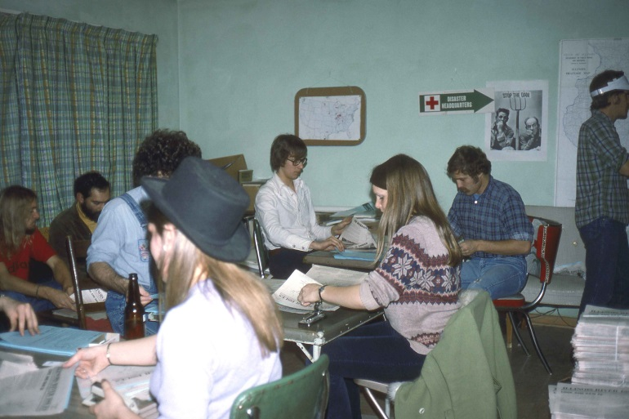
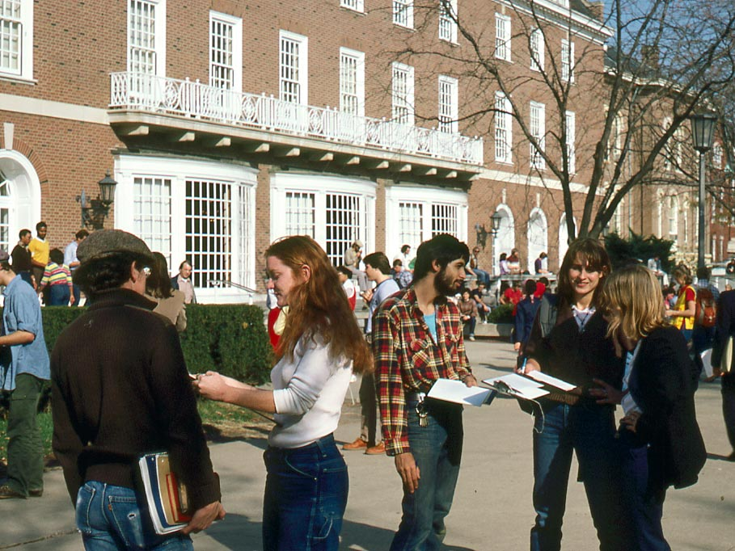
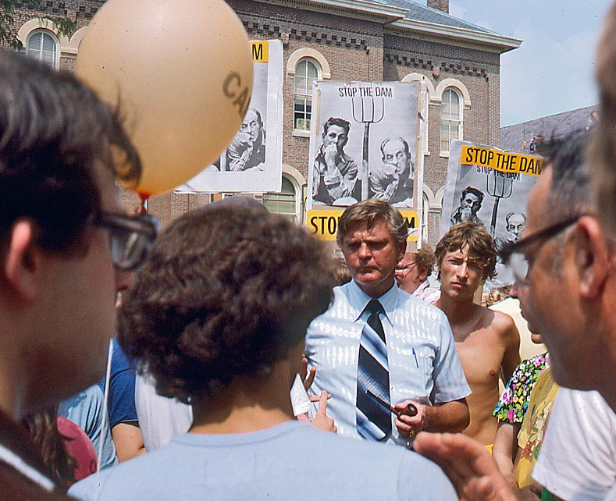
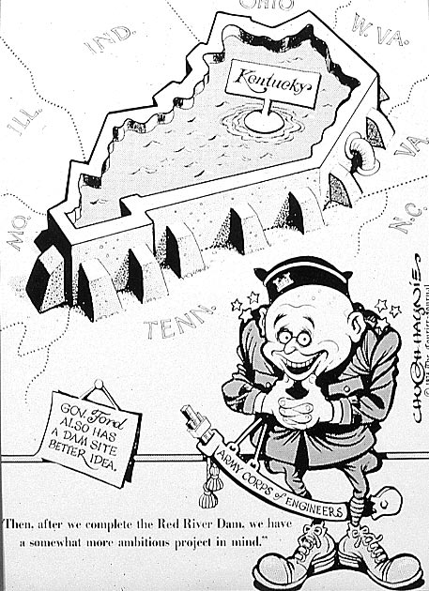
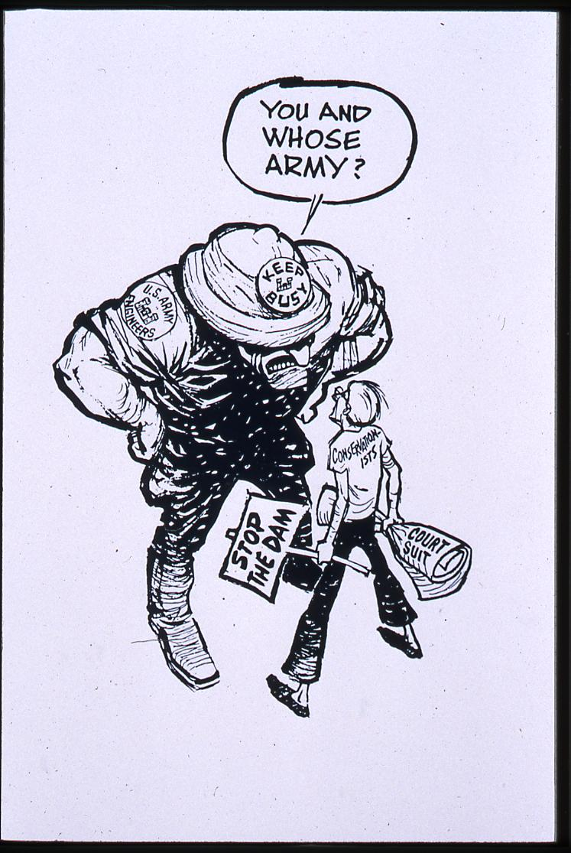
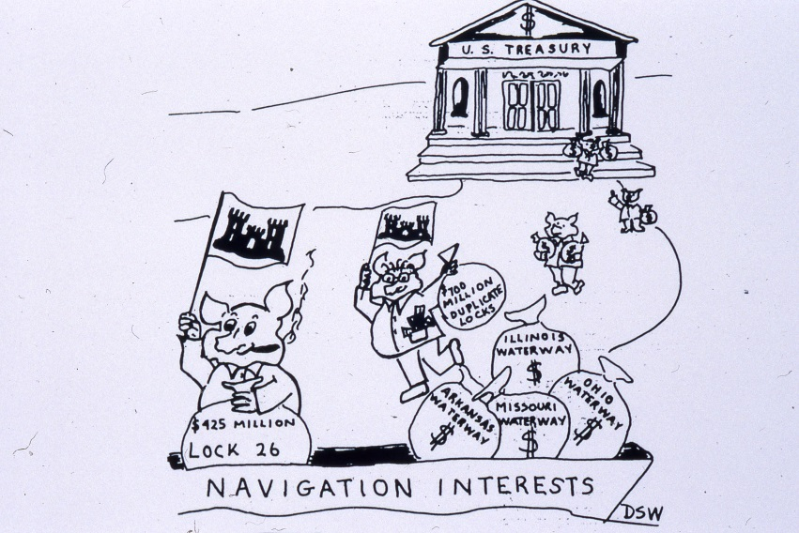
1970s: Stopping Unwise Army Corps of Engineer Projects

Slide 5
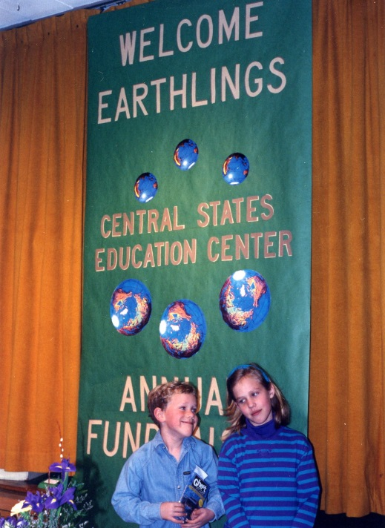
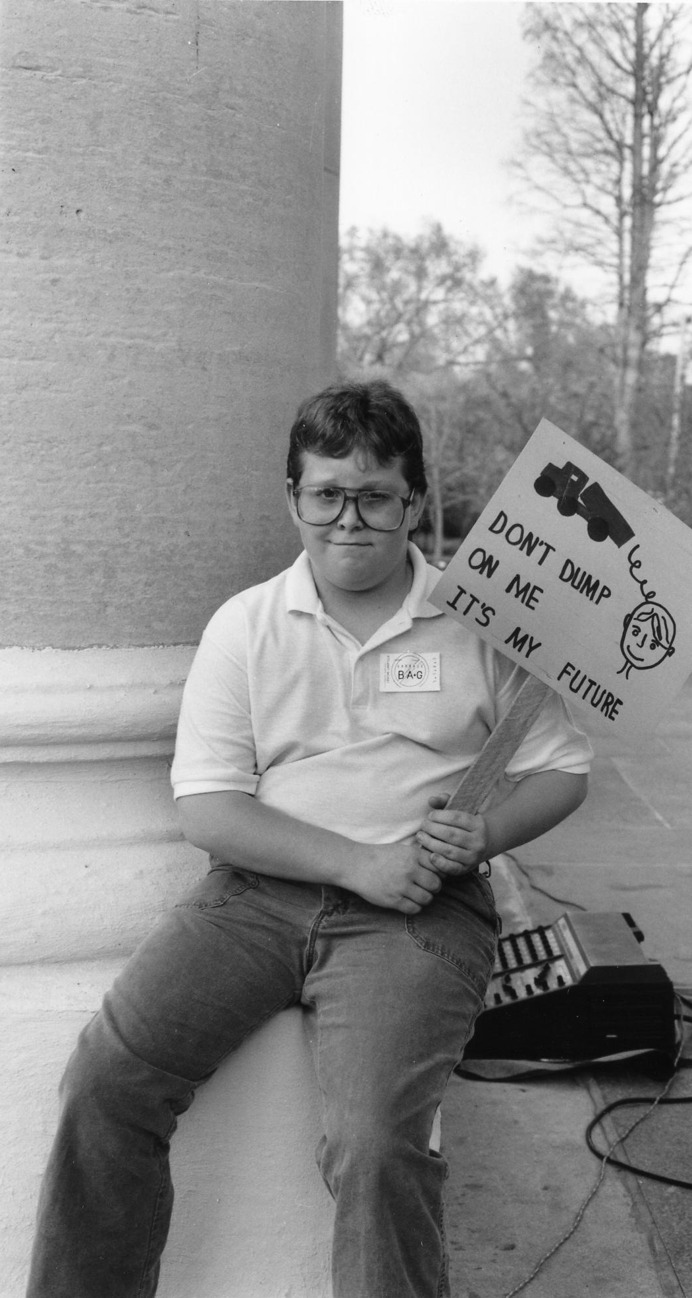
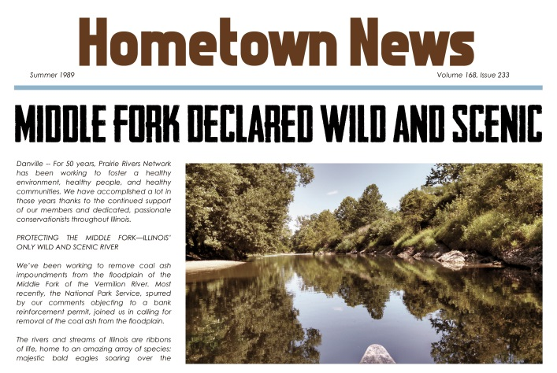
1980s: Fighting Waterway Degradation & Hazardous Landfills

Slide 6
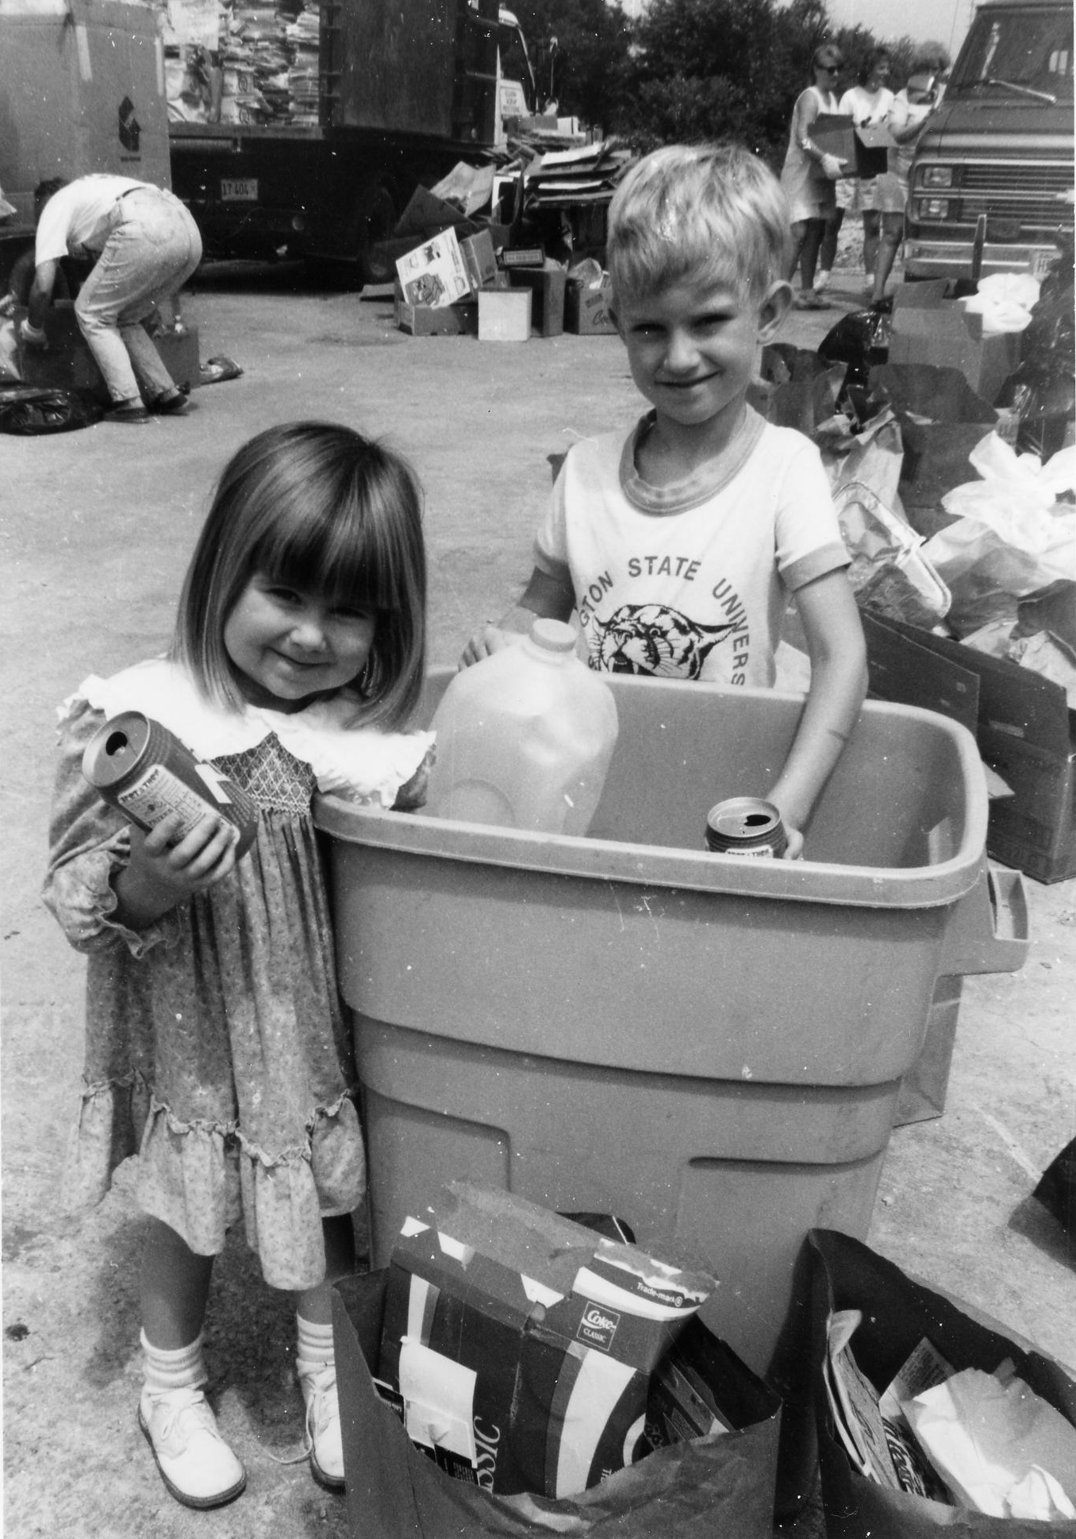
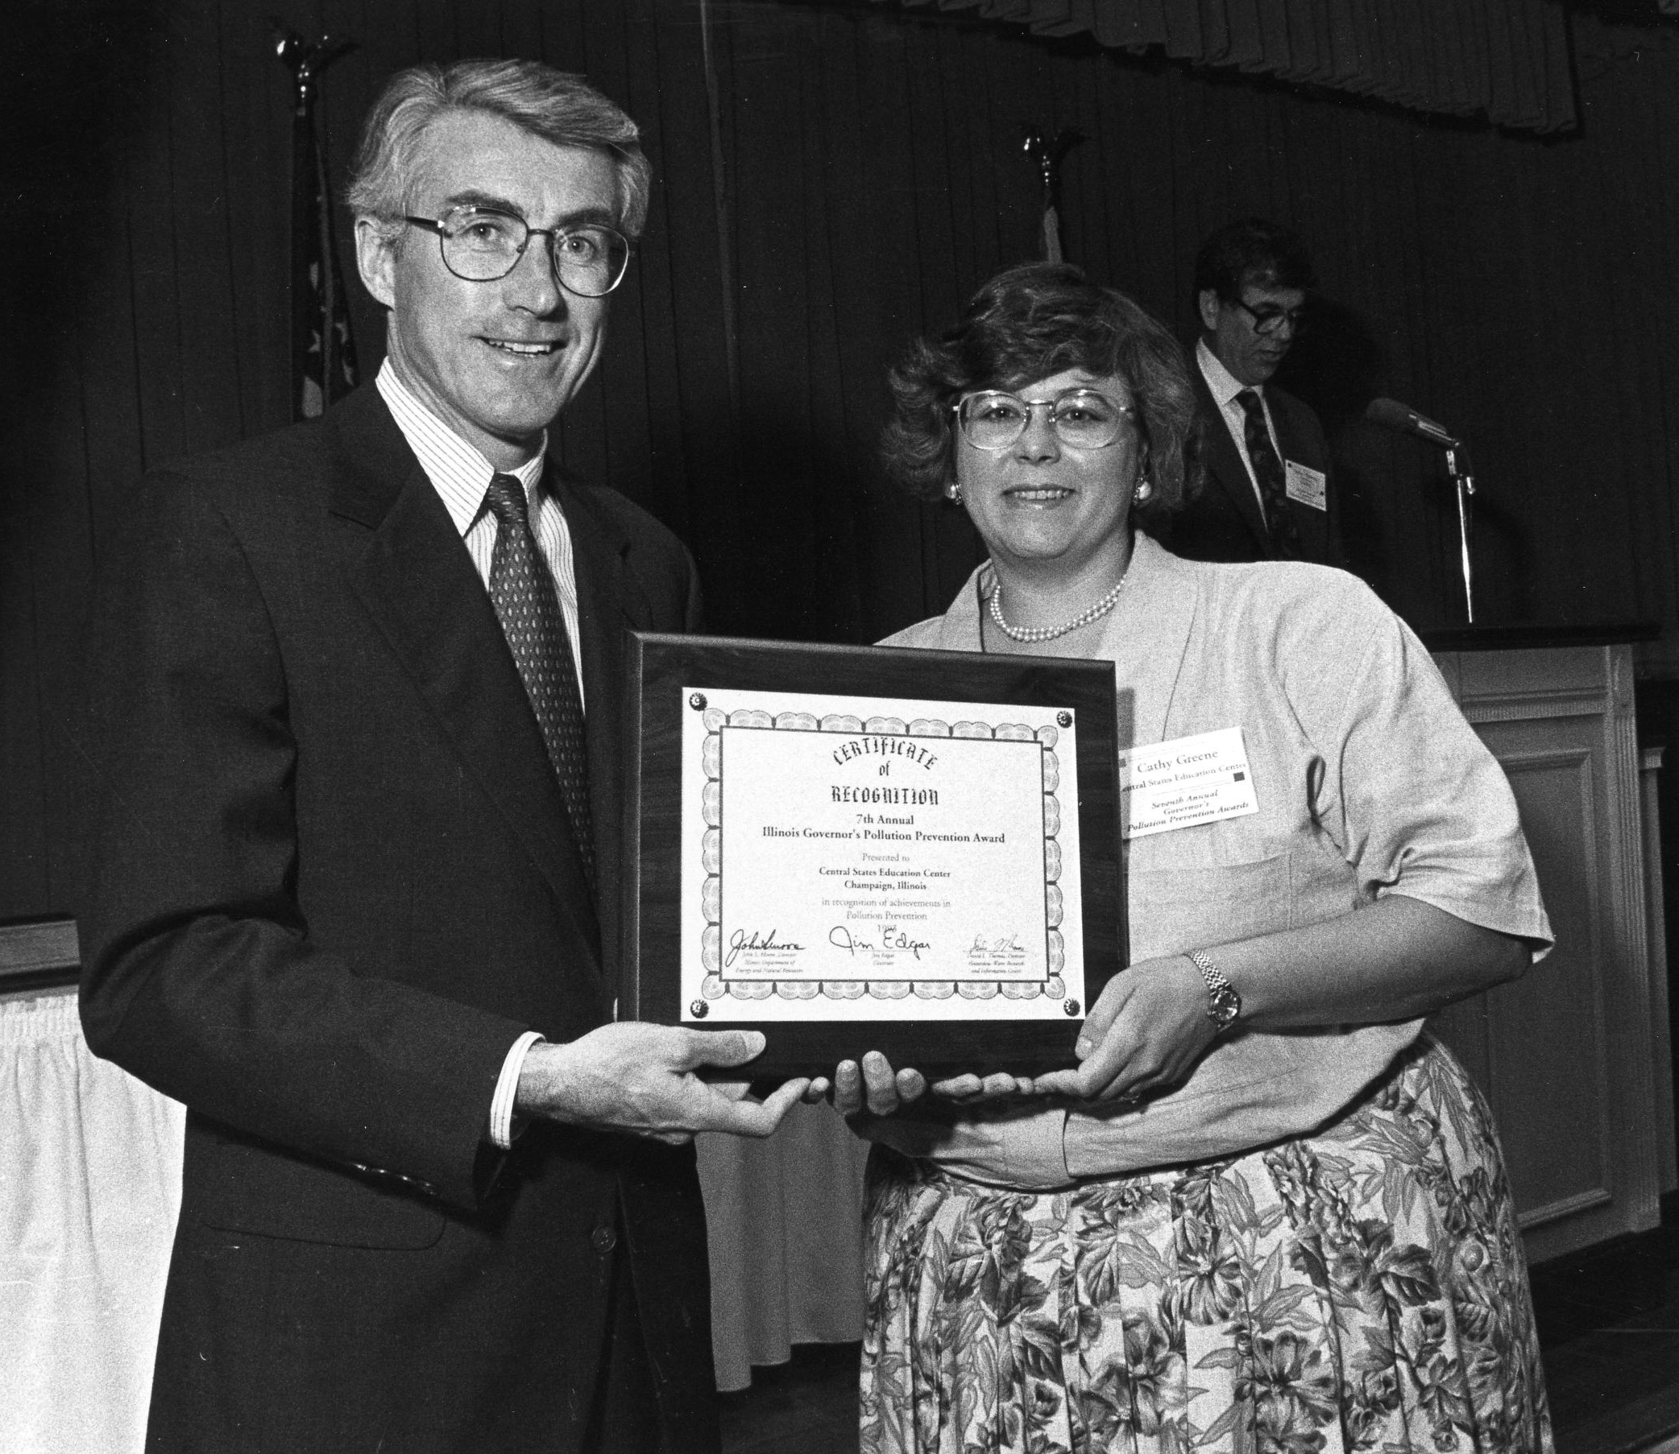
1990s – Reducing Waste Through Model Communities

Slide 7
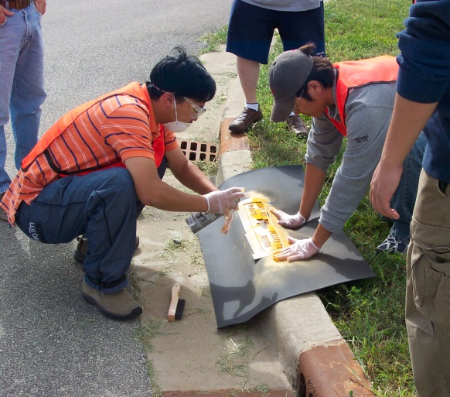
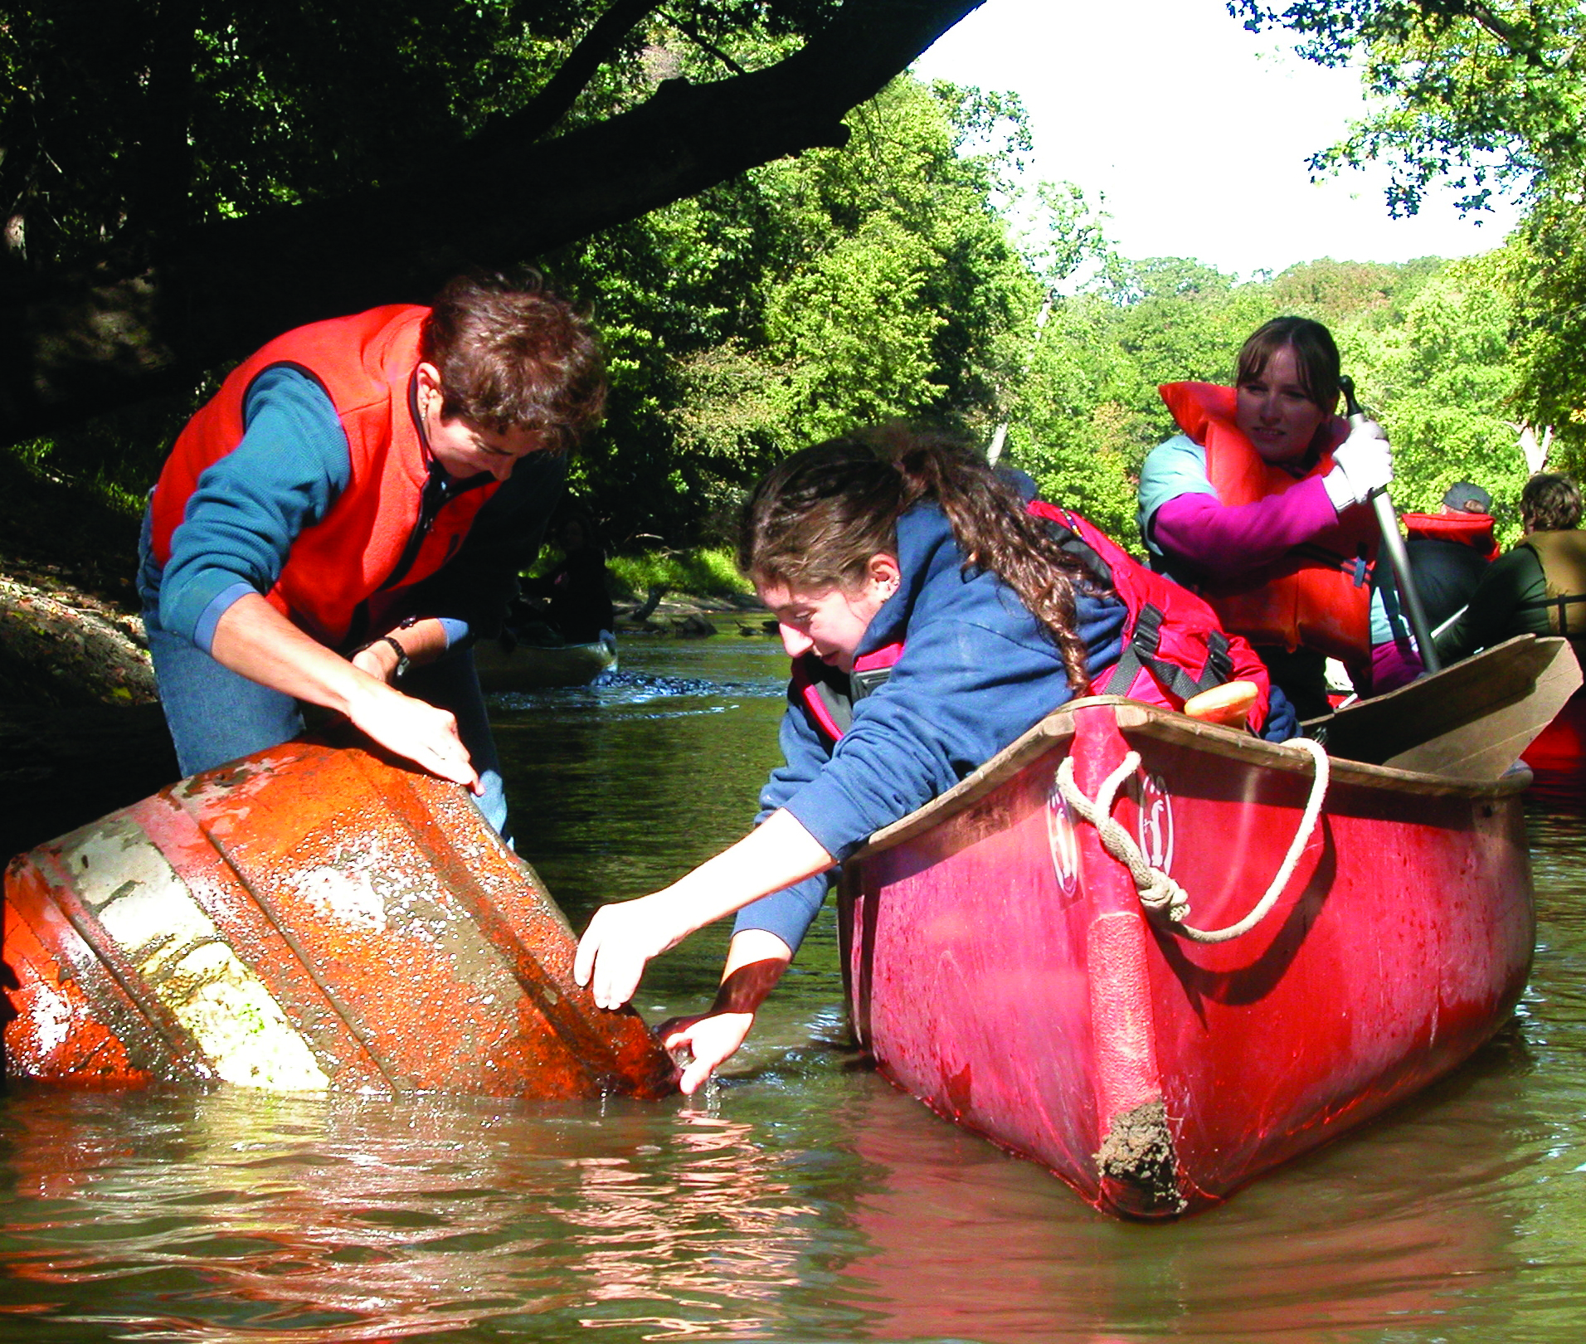
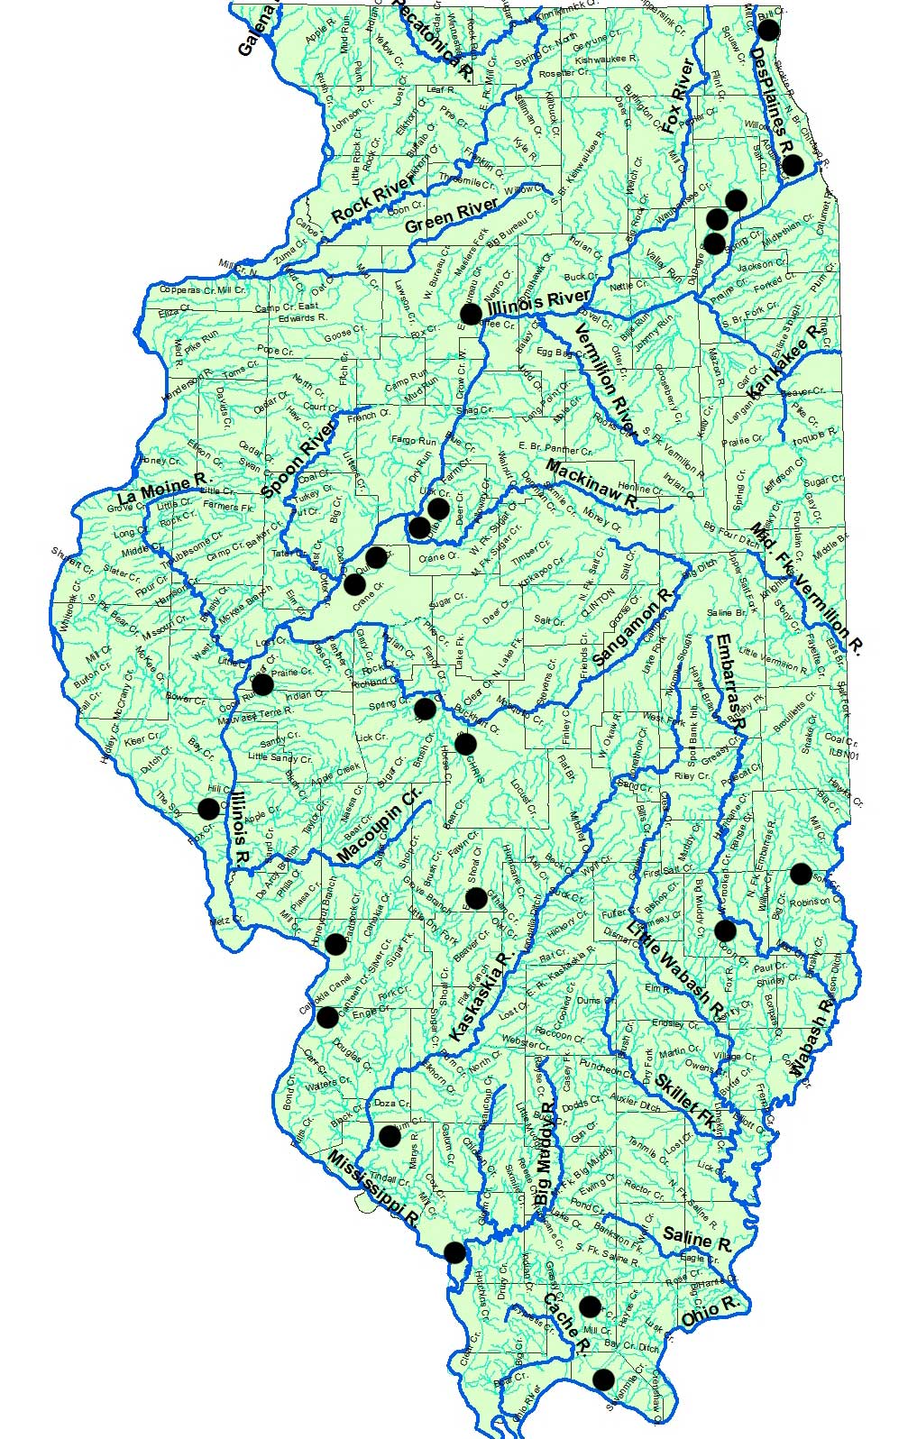
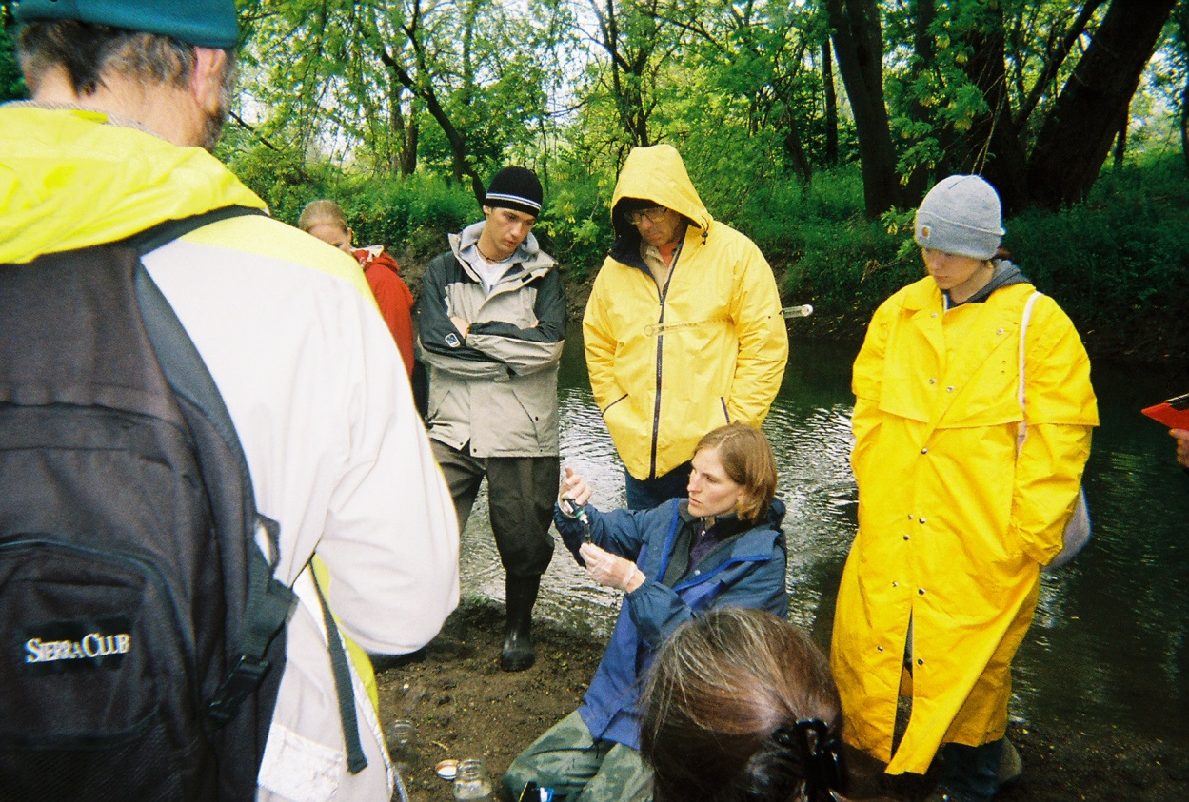
2000s – Protecting Rivers Using the Clean Water Act
Illinois’ 24
coal-fired power plants

Slide 8
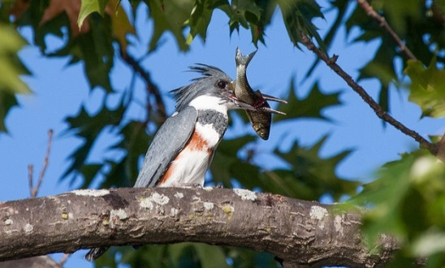
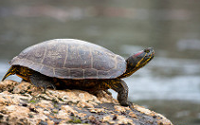
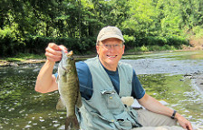
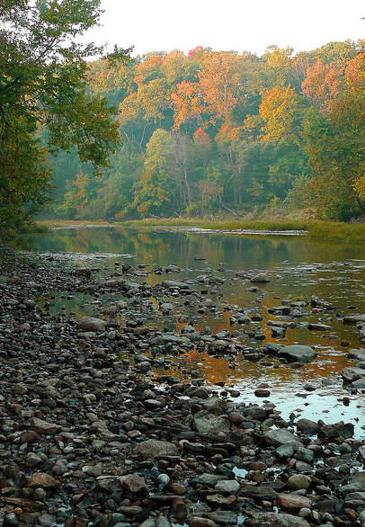
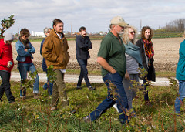
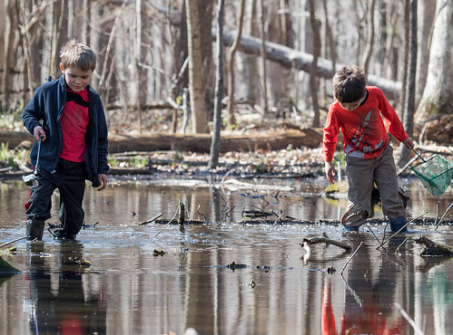
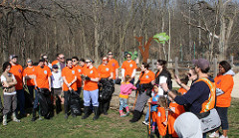
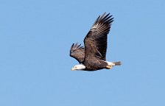
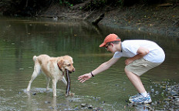
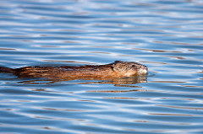
2010s – Clean Water, Wildlife, Reconnecting Rivers & Wetlands

Slide 9
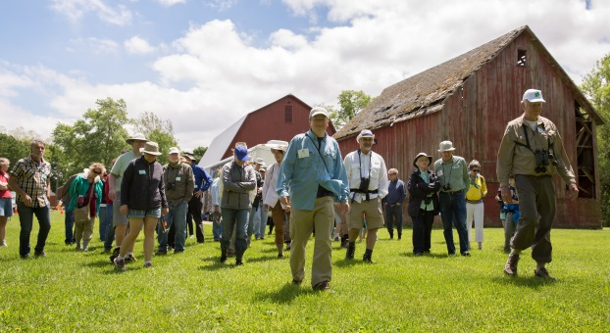
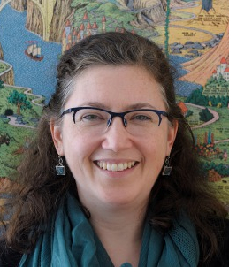
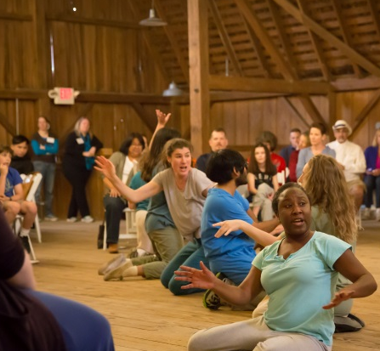
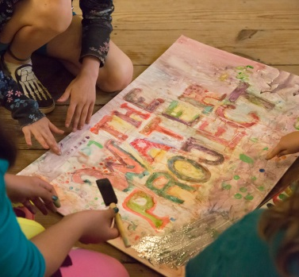
Volunteers of the Year
Latrelle Bright, Amy Hassinger, and
Kate McDowell

Slide 10
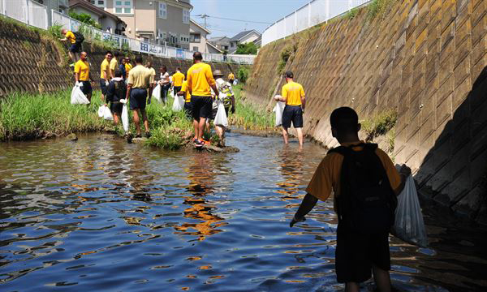
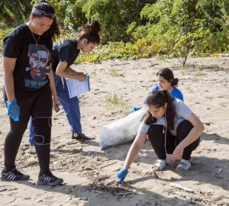
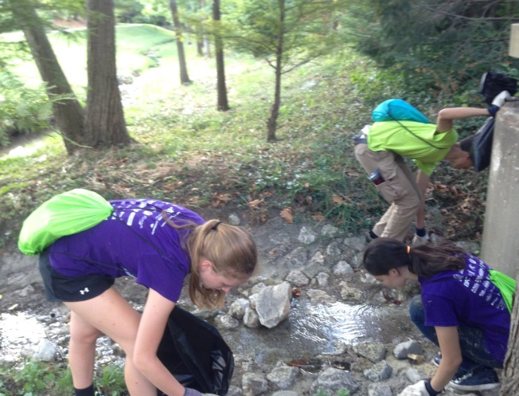
River Steward Award Winners
Randy Smith and Seth Brady

Slide 11
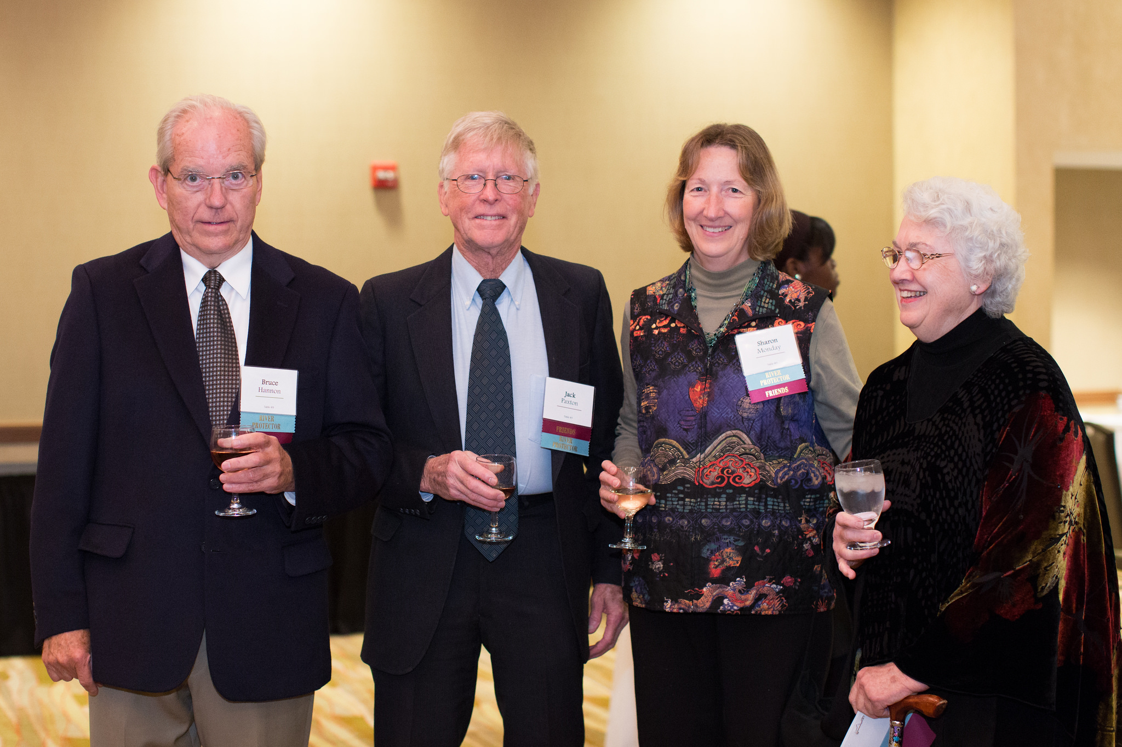
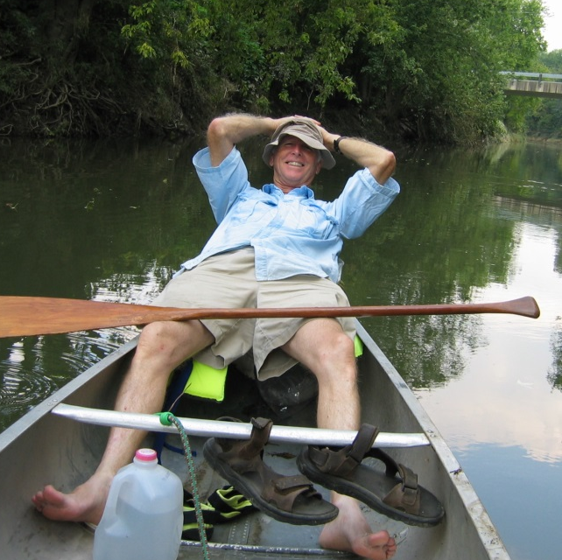
Thank You Bruce, Jack, Sharon, and Patricia

Slide 12
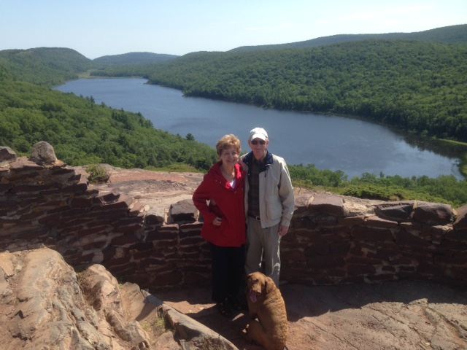
Thank You Annette and Chuck

Slide 13
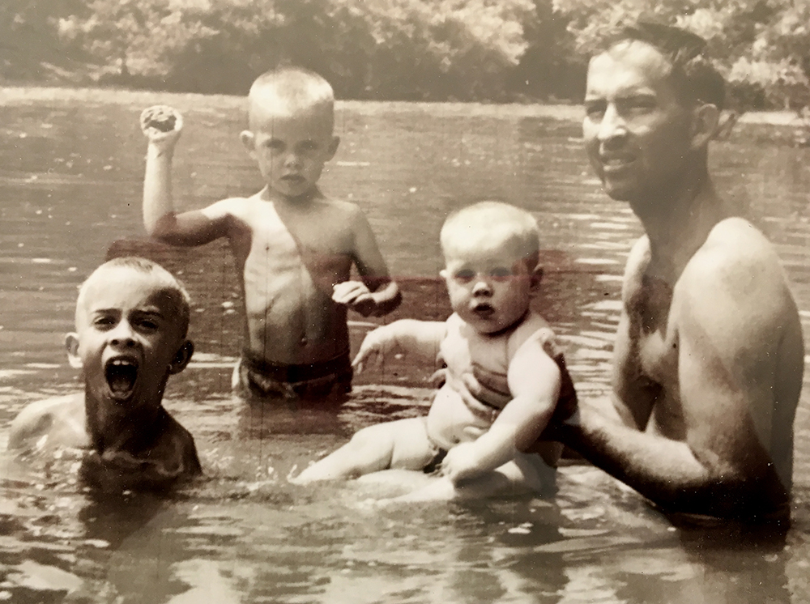
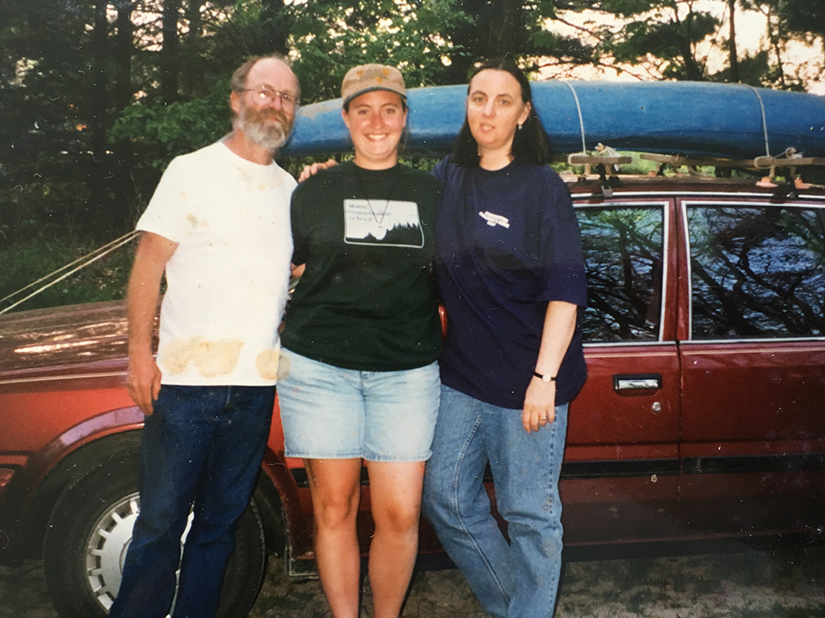
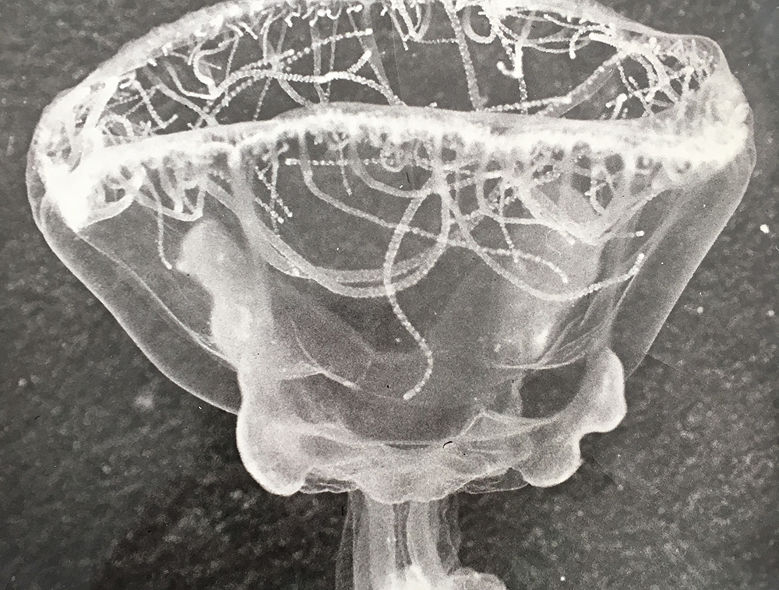
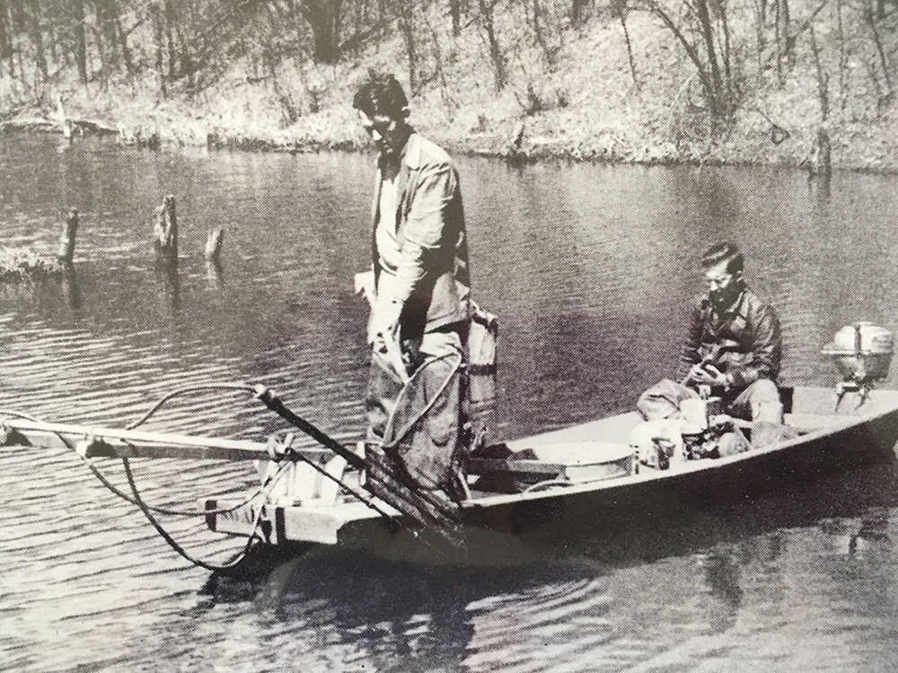
Thank You Larimore Family

Slide 14
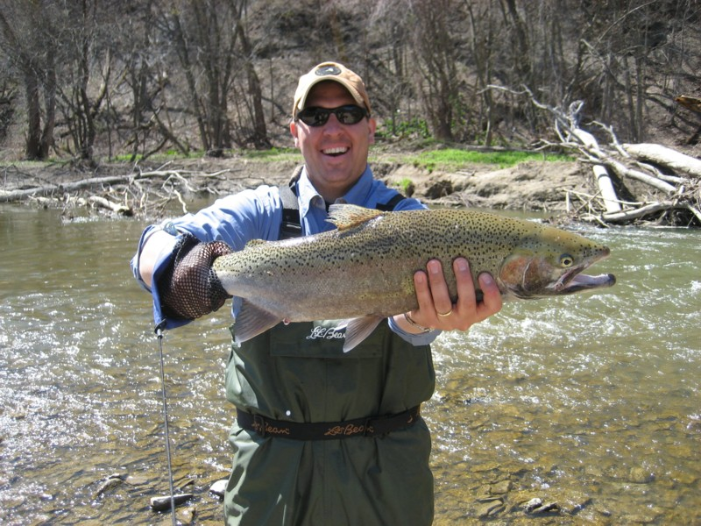
Thank You Marc and NWF

Slide 15
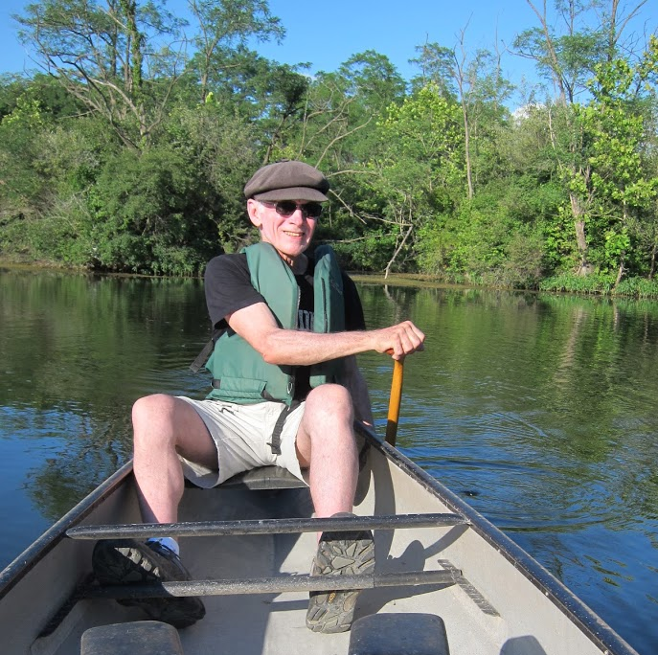
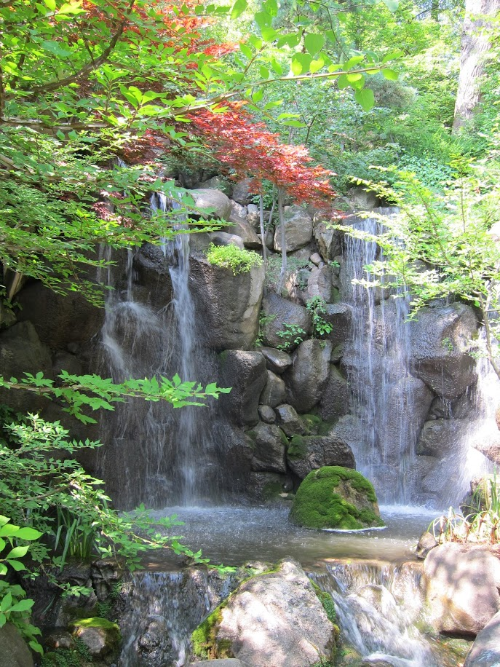
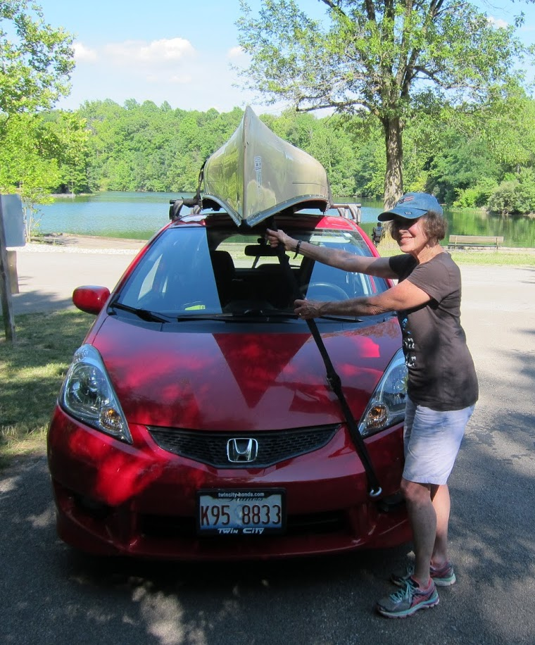
Thank You Carolyn and Ralph
Notes:
Paddle boat at Sunrise over the Mississippi River, Upper Mississippi River National Fish and Wildlife Refuge, Pikes Peak State Park, Iowa

Slide 16
Thank You Fran, Heather, and Majela

Slide 17
Thank You Marriott Family
Notes:
Salt Fork River

Slide 18
Thank You Lynn and Ira

Slide 19
Thank You Sue and Lew

Slide 20
Thank You Sponsors
Blue Moon Farm • Consolidated Communications • First Mid-Illinois Bank & Trust
Erich Adickes Photography • I Hotel and Conference Center • National Wildlife Federation
Anderson Farms • Blue Boutique • Hartke Engineering and Surveying • Kickapoo Adventures • Marco Technical Documentation
Notes:
Middle_fall_a

Slide 21
Thank You Bales Family
Notes:
Ancient bald cypress tree during autumn at Cache River State Natural Area in southern Illinois. This ancient tree is the Illinois State Champion Bald Cypress. It is over 40 feet in circumference and is estimated to be 1,000 or more years old. It is probably the oldest living thing in Illinois and possibly the oldest living thing east of the Rocky Mountains.

Slide 22
Thank You Mare and Jim

Slide 23
Thank You Anne and Allan

Slide 24
Thank You Chris and David

Slide 25
Thank You Lew, Sue, Carol, and Frank

Slide 26
Thank You Jennifer and in Loving Memory Bill

Slide 27
Thank You River Stewards & Volunteers of the Year Winners

Slide 28
Thank You Dixie and Gary

Slide 29
Thank You Partners
Canton Area Citizens for Environmental Issues
Citizens Against Longwall Mining
HEARTLAND COALFIELD ALLIANCE

Slide 30
Thank You Glynnis and Nick

Slide 31
Thank You Members for Taking Action

Slide 32
Thank You Beth and Tod

Slide 33
Thank You Kim and Melissa and Family

Slide 34
Thank You Scott

Slide 35
Thank You Wes and Leslie and Prairie Fruits Farm

Slide 36
Thank You Nancy and in Loving Memory of Charles

Slide 37
Thank You Sue and Tom

Slide 38
Thank You Funders

Slide 39
Thank You Rebecca and Betsy

Slide 40
Thank You Irene and Clark

Slide 41
Thank You Carol

Slide 42
Thank You Diane and John

Slide 43
PRN Staff and Executive Directors Through the Years
John Thompson E.D. 1984-1996 &
Dixie Jackson Office Manager 1986-2005
John Marlin
E.D. 1973-1983
Rob Moore
E.D. 1996-2002
Jean Flemma
E.D. 2003-2007
Carol Hays
E.D. 2015-Today
Glynnis Collins E.D. 2008-2015

Slide 44
What’s in a Name?
1967
Committee on Allerton Park
established as a 501(c)(3)
1984
Committee on Allerton Park becomes
Central States Education Center
1998
Central States Education Center becomes
1973
Members from
Committee on Allerton Park
also form the
Coalition on American Rivers
as a 501(c)(4)
1979
Coalition on American Rivers becomes Central States Resource Center
2006
Coalition on American Rivers Discontinues

